Slide 1
BASIC COMP. ARCHITECTURE Bachelor of Computer Science (Hons) (Network Technology and Cybersecurity) MODULE CODE: BCA114

Slide 2
CLO 2

Slide 3
The Computer System
Hardware
Software
Data
People

Slide 4
Computer Organisation and Architecture
Computer architecture: the definition of basic attributes of hardware components and their interconnections, in order to achieve certain specified goals in terms of functions and performance.
Computer organization: the design and physical arrangement of various hardware units to work in tandem, in a orderly manner, in order to achieve the goals specified in the architecture.

Slide 5
Central Processing Unit
The main operations of the CPU include four phases:
(1) Fetching instructions from the memory
(2) Decoding the instructions to decide what operations to be performed
(3) Executing the instructions
(4) Storing the results back in the memory

Slide 6
Central Processing Unit
Registers
Arithmetic Unit
Logic Unit
Control Unit

Slide 7
Arithmetic Unit
Arithmetic Unit is a part of the CPU that performs arithmetic operations on the data. The arithmetic operations can be addition, subtraction, multiplication or division.

Slide 8
Logic Unit
Logic Unit is a part of the CPU that performs logical operations on the data.

Slide 9
Control Unit
Control Unit is an important component of CPU that controls the flow of data and information. It maintains the sequence of operations being performed by the CPU.

Slide 10
Main Memory Unit
The main memory is referred to as the internal memory of primary memory of the computer. It is also known as Random Access Memory (RAM).

Slide 11
Cache Memory
Cache memory is a small, fast and expensive memory that stores the copies of data that needs to be accessed frequently from the main memory.

Slide 12
Registers
CPU contains a few special purpose, temporary storage units known as registers. They are high-speed memory locations used for holding instructions, data and intermediate results that are currently being processed.

Slide 13
Internal Communications
The internal communication of a processor in the computer system can be divided into two major categories:
(1) Processor to memory communication
(2) Processor to I/O devices communication

Slide 14
Processor to Memory Communication
The direct communication between the processor and memory of the computer system is implemented with the help of two registers:
(1) Memory Address Register
(2) Memory Buffer Register
The reading and writing operations performed by the processor are called memory read and memory write operations.

Slide 15
Processor to I/O Devices Communication
The communication between I/O devices and processor of the computer system is implemented using an interface unit. The interface unit acts as an intermediary between the processor and the device controllers of various peripheral devices in the computer system.

Slide 16
Machine Cycle
The cycle during which a machine language instruction is executed by the processor of the computer system is known as machine cycle.

Slide 17
Instruction Cycle
Fetching: The CPU retrieves the instruction from the main memory of the computer system.
Decoding: Breaking down the instruction into different parts, so that it can be easily understood before being processed by the CPU.

Slide 18
Execution Cycle
Executing: The decoded instruction is executed by the ALU of the CPU.
Storing: The result computed in the execution phase is either sent to the memory or to an output device.

Slide 19
The Bus
A bus is a set of wires that is used to connect the different internal components of the computer system for the purpose of transferring data as well addresses amongst them.
Data bus: used to transfer data amongst the different internal components. Modern computer systems use 32-bit data buses for data transfer.
Address bus: transfers the memory addresses for read and write memory operations.

Slide 20
Memory and Storage Systems
Primary Memory: Storing the data that are being currently handled by the CPU; generally known as “memory”;
Secondary Memory: Storing the results and the data for future use; generally known as “storage”;
Internal Process Memory: Placed either inside the CPU or near the CPU.

Slide 21
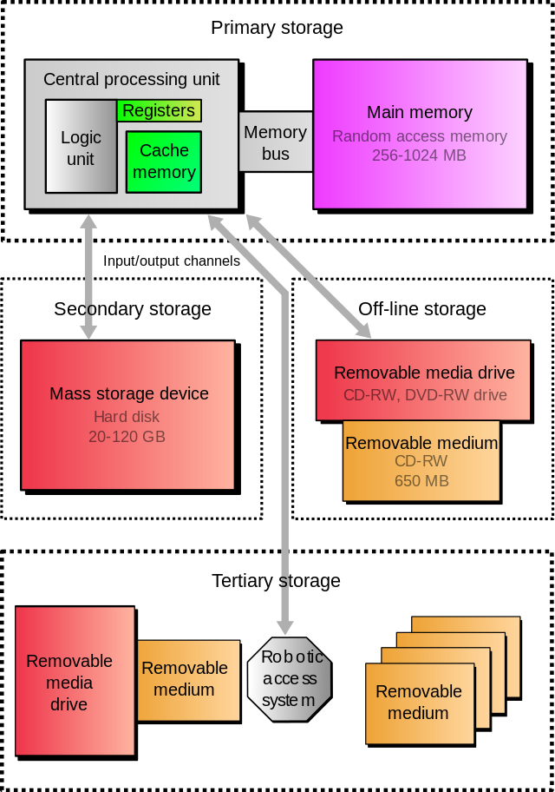

Slide 22
Hierarchy of storage
Primary storage
Secondary storage
Off-line storage
Tertiary storage

Slide 23
PRIMARY STORAGE
CPU
ALU
Registers
CACHE
RAM
ROM

Slide 24
Memory Representation
In the memory, values are represented by sequences of binary digits, know as bits. Most computers use a group of eight bits, known as a byte, to represent a character.
Memory is a “bunch” of bytes or cells into which we can place data. Each cell, known as a data item, is assigned a unique number known as “address”. The CPU can identify each cell by its address.

Slide 25
Memory Representation
The byte is defined as the “smallest addressable unit” of memory. Most computers use groups of bytes, usually 2 or 4, known as “words” to represent information.
Computer memories are often rated in terms of their capacity to store information. Typically, capacities are described using the unit of byte as follows:
(1) 1 KB (Kilobyte)=1,024 bytes
(2) 1 MB (Megabyte)=1,048,576 bytes
(3) 1 GB (Gigabyte)=1,073,741,824 bytes
(4) 1 TB (Terabyte)=1,099,511,627,776 bytes

Slide 26
Random Access Memory
Random Access Memory (RAM) is a volatile memory and loses all its data when the power is switched off.
It is the main memory of the computer system that stores the data temporarily and allows the data to be accessed in any order.
RAM can be categorised into two main types, namely, Static RAM and Dynamic RAM.

Slide 27
Random Access Memory
Static RAM: is a type of RAM in which data is stored till the power of the computer system is switched on. SRAM uses a number of transistors to store a single bit of digital information.
Dynamic RAM: is the RAM in which data is stored in a storage cell, consisting of a transistor and a capacitor. The DRAM needs to be continuously refreshed with power supply because the capacitor has the tendency to get discharged. DRAM retains the data for a very short span of time, even after the power supply is switched off.

Slide 28
Read Only Memory
ROM is the memory that stores the data permanently.
The data can be easily read from this type of memory but cannot be changed.
ROM is most commonly used in devices such as calculators, laser printers, etc.
ROM does not allow the random access of data, and allows sequential access of data.

Slide 29
Read Only Memory
ROM is divided into four types:
(1) Programmable ROM: a memory chip on which the write operation of data can be performed only once. PROM is reliable and stores the data permanently without making any change in it. It is mostly used in video games and electronic dictionaries.
(2) Erasable PROM: a type of ROM in which data can be erased or destroyed using Ultraviolet Light.
(3) Electrically Erasable PROM: a type of ROM in which data can be erased or destroyed by exposing it to an electric charge.
(4) Flash ROM: a type of EEPROM that stores the information using floating-gate transistors, which can store electric charge for a longer period of time as compared to the normal transistors. This memory is mainly used in the memory cards of mobile phones, digital cameras and ipods for storing data. Flash ROM has faster speed of reading data, as compared to any other type of ROM.

Slide 30
Storage Systems
Storage systems are the devices used for data storage. The main objective of the storage system is to permanently store data. The storage systems can be classified as follows:
(1) Magnetic
(2) Optical
(3) Solid state
(4) Magneto Optical

Slide 31
Magnetic Storage Systems
Magnetic storage systems can be defined as the storage systems that store the data on a magnetized medium, with the help of magnetised particles. Magnetic tapes, magnetic disks, hard disks, floppy disks are examples of magnetic storage systems.
Can store any type of data, such as text, audio, video, image

Slide 32
Magnetic Storage Systems
Magnetic tapes: The plastic tapes with magnetic coating that are used for storing the data. They are similar to the normal recording tapes. The data stored on the magnetic tapes can be accessed using the sequential access method.
Magnetic Disks: A flat disk that is covered with magnetic coating for holding information. It is used to store digital information in the form of small and magnetised needles. These needles help in encoding a single bit of information by getting polarized in one direction represented by 1, and opposite direction represented by 0. It allows the random access of data and provides the facility of erasing and re-recording the data as many times as required.

Slide 33
Optical Storage Systems
The optical storage systems use the laser light as the optical medium to retrieve as well as record data.
The optical storage devices are either read-only or writable.

Slide 34
Solid-State Storage Devices
Solid-state Storage Devices were developed in 1978 by Storage Tek Company.
Do not use magnetic and optical medium to store data. Instead, use the semiconductor devices.
Contains all the properties of hard disk drives to store the data and use solid-state memory, which has no moving parts.
The examples of SSD are flash memory cards and Universal Serial Bus (USB) devices.

Slide 35
Storage Evaluation Criteria
Access Mode: random access mode, sequential access mode, direct access mode
Access Time: the time taken by the processor in completing the requests made by the user for performing the read and write operations.
Storage Capacity: the size of the memory available for storing the data, and measured in terms of bytes.
Storage Type: Temporary and permanent memory.
Cost: the cost of the storage device used in the computer system for holding the data.

Slide 36
Input Devices
Input devices are electromechanical devices that are used to provide data to a computer for storing and further processing, if necessary.
We can provide the input to a computer in two ways: (1) Manually through devices such as keyboard and mouse;
(2) Directly from documents using devices such as scanners.

Slide 37
Input Devices
Depending upon the type or method of input, the input device may belong to one of the following categories:
(1) Keyboard
(2) Pointing devices
(3) Scanning devices
(4) Optical recognition devices
(5) Digital camera
(6) Voice recognition devices
(7) Media input devices

Slide 38
Keyboard
Keyboard is the most commonly used input device. We can use a keyboard to type data and text and execute commands. A standard keyboard consists of the following groups of keys:
(1) Alphanumeric keys: The alphanumeric keys include the number keys and alphabet keys. These keys are arranged in the same style as in the normal typewriters, popularly known as QWERTY layout;
(2) Function keys: Arranged in a row on the top of the keyboard. Help perform specific tasks, such as searching a file or refreshing a web page;
(3) Central keys: Used for controlling the movement of cursor and screen display. Include arrow keys, modifier keys such as SHIFT, ALT, CTRL;
(4) Numeric keypad: Located on the right side of the keyboard. This looks like a calculator’s keypad;
(5) Special purpose keys: Escape, Insert, Delete, Print Screen, Pause, Tab, Spacebar;

Slide 39
Pointing Devices
Pointing devices are the input devices that are generally used for moving the cursor to a particular location to point an object on the screen. With the help of pointing devices, we can easily select the icons, menus, windows, etc on the Graphical User Interface. Some of the commonly used pointing devices are:
(1) Mouse
(2) Trackball
(3) Light pen
(4) Joystick
(5) Touchscreen

Slide 40
Mouse
A small hand-held pointing device that basically controls the two-dimensional movement of the cursor on the displayed screen. The most commonly used types of mouse are:
(1) Mechanical mouse
(2) Optical mouse

Slide 41
Scanning Devices
Scanning devices are the input devices that can electronically capture text and images, and convert them into computer readable form.
The basic task of a scanning devices is to convert an image or the textual data into digital data, i.e., in the form of boxes, where each box represents either zero or one. The resultant matrix is known as bit map and is displayed on the screen.

Slide 42
Scanning Devices
The scanning devices can be differentiated from each other on the basis of the following characteristics:
Resolution: the closeness of the pixels in the bit map, and vary from 72 to 600 dots per inch (dpi);
Size: the small sized scanning device can scan approximately two to five inches of the document, whereas the large sized one can scan approximately up to forty inches of the document.

Slide 43
Optical Recognition Devices
Optical Mark Recognition (OMR) devices: help in obtaining the data from the marked fields. These devices prove to be of great use in recognizing characters in question sheets, enrolment forms, registration forms, employee payroll, etc. Most popularly, the OMR devices are used for scanning the documents having multiple choices as in the question papers used in schools, colleges, etc.

Slide 44
Digital Camera
A digital camera is a handheld electronic device that is used to capture the image of an object electronically. The digital camera consists of a built-in computer, which helps in recording the images electronically. The following are the main features of the digital camera:
Capturing and storing thousands of images on a single memory chip
Editing as well as deleting the images
Recording the video clip with sound
Showing the just recorded video clip on the camera screen

Slide 45
Digital Camera
The image captured by a digital camera is in the digital format and can be easily downloaded on a computer system.
The quality of the pictures captured by a digital camera depends on the resolution factor. The more the resolution of a digital camera, the better is the image quality.

Slide 46
Voice Recognition System
The voice recognition devices generally record the voice of a person and transform it into electrical signals. The electrical signals are then converted into the machine readable code.
The voice recognition system only recognizes the voice of the speaking person rather than what he speaks.
The voice recognition devices are used for various purposes such as dictation, training air-traffic controllers, etc. These systems allow users to communicate with computers directly without using a keyboard or mouse.

Slide 47
Data Acquisition Sensors
Sensors are the devices that are used for detecting and measuring the physical quantities, such as heat, temperature, and converting them into electrical signals. The sensors are most commonly used in data acquisition systems.
The data acquisition system collects the electrical signals from various devices and converts them into the digital signals for further assessment.

Slide 48
Media Input Devices
The input devices, which are generally used in media for communicating with the mass audiences, are known as media input devices. The following are the most popularly used media input devices:
Microphone
Webcam
Graphics tablet

Slide 49
Output Devices
Output devices receive the processed data (information) from the CPU and present it to the user in a desired form. They act as an interface between the computer and the user. The main task of an output device is to convert the machine readable information into human-readable from which may be in the form of text, graphics, audio or video. Depending upon the form of output required, the output device may belong to one of the following categories:
Display monitors
Printers
Plotters
Voice output systems
Projectors

Slide 50
Output Devices
While the printers and plotters provide the physical form of output known as hard copy, the display monitors, voice output systems and projectors provide temporary output known as soft copy. Unlike hard copy, soft copy is not a permanent form of output.

Slide 51
Display Monitors
Cathode Ray Tube (CRT) Monitor: contain an empty glass tube with a phosphor coated fluorescent screen and a source of electrons known as electron gun. A CRT monitor has many advantages, such as a high contrast ratio and color depth. It also provides a change in the resolution without affecting the clarity of the picture. But it is very bulky and occupies a lot of space on the desk. It also consumes a lot of power and produces a large amount heat.

Slide 52
Display Monitors
Liquid Crystal Display (LCD) Monitor: Use liquid crystals technology to display the images. An LCD monitor is small in size and light in weight so it occupies less space on the desk. Also, the power consumption by an LCD monitor is very less. However, it has a weak color quality as compared to a CRT monitor.
Thin Film Transistor (TFT) Monitor: A TFT monitor is similar to an LCD monitor except for one difference that it uses thin film transistor technology along with liquid crystal technology to improve the quality of the image.

Slide 53
Printers
A printer is a computer hardware that generates the hard copy of the information processed by a computer system.
Impact Printers: there exists a mechanical contact between print head and paper. Print head is the part of the printer that resembles a hammer and is responsible for transferring the ink to the paper in the form of required characters. Impact printer contains an individual print head for each character.
Non-Impact Printers: there exists no mechanical contact between the print head and paper. These printers spray ink on the paper with the help of a nozzle. The most popular ones are ink-jet printers and laser printers.

Slide 54
Plotters
Plotter is a device used to print high quality graphics and images. It uses one or more pens to produce a high quality drawing. These pens change their positions and draw continuous lines to produce an image. The plotters were used as a substitute to the colored printers when the printers were very expensive and were also not capable of drawing bigger images such as graphs.

Slide 55
Voice Output Systems
Voice output systems record the simple messages in human speech form and then combine all these simple messages to form a single message. The voice response system is of two types: (1) a reproduction of human voice and other sounds; (2) speech synthesis.
The basic application of a voice output system is in Interactive Voice Response systems, which are used by the customer care or customer support departments of an organization, such as telecommunication companies, etc.

Slide 56
Projectors
A projector is a device that is connected to a computer or a video device for projecting an image from the computer or video device onto the big white screen.
A projector consists of an optic system, a light source and displays, which contain the original images.
Projects were initially used for showing films but now they are used on a large scale for displaying presentations in various situations.

